Slide 1

LITHUANIAN - HUNGARIAN FINTECH FORUM & B2B
Vilnius, 23.05.2019
The PAYPAL with Google business model
Sándor Kiss, Barion, Hungary

Slide 2
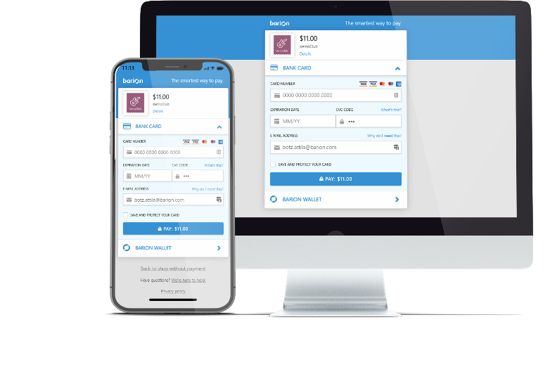
Intro
2
Notes:
2

Slide 3
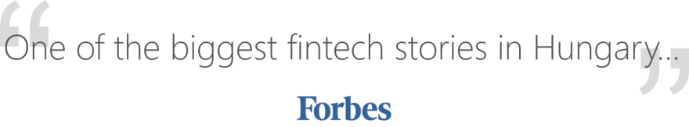
Barion is a better PayPal with Google’s business model.
3
Notes:
Introduction
Who are you and why you're here?
3

Slide 4
Online merchants want more customers
and
lower costs.
4
Notes:
Problem
What problem are you trying to solve? Is it really a problem?
4

Slide 5
Barion solves
both problems
with a killer combination of
fintech, adtech and
big data.
5
Notes:
Advantages
What makes your solution special? How are you different from others?
5

Slide 6
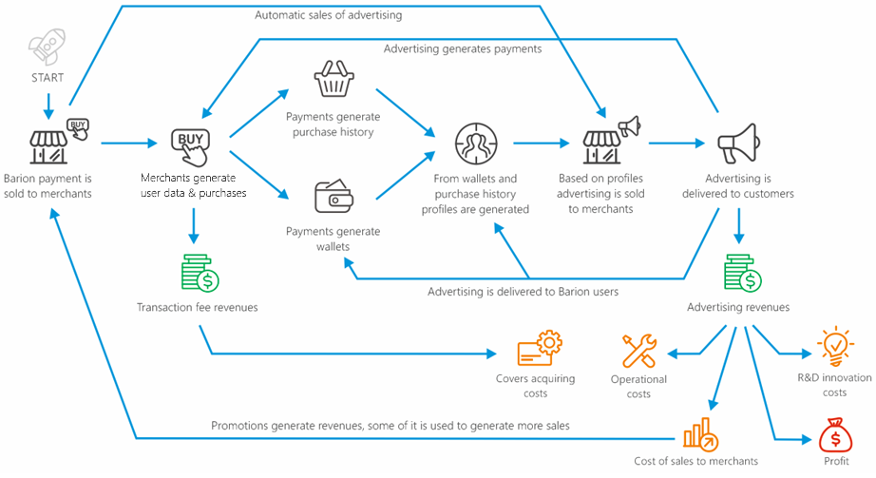
Business model: profit on ads instead of fees
„Barion Pay” - low cost payment gateway.
Consented data in return for low fees.
„Barion Ad” profiles users.
We sell ads on „Barion Accounts”, so merchants get more customers.
6
Notes:
Solution
Describe how are you planning to solve the problem:
- Barion Pay, Barion Accounts, Barion Ad
6

Slide 7
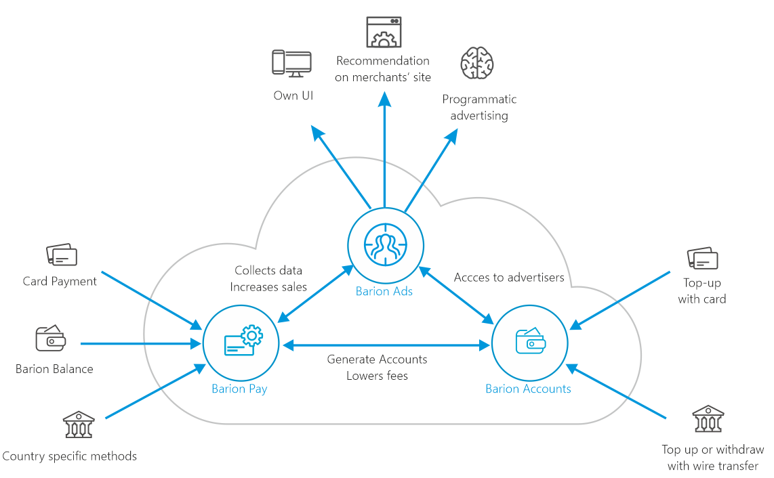
Barion summary
7
Notes:
7

Slide 8

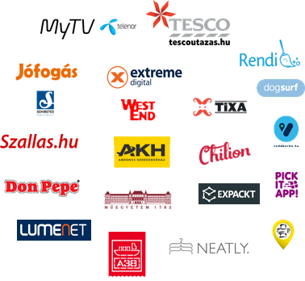

Barion Pay: Smart Gateway with low fees and fast contracting
8
Notes:
Product
How does your product or service actually work? Show some examples.
8

Slide 9
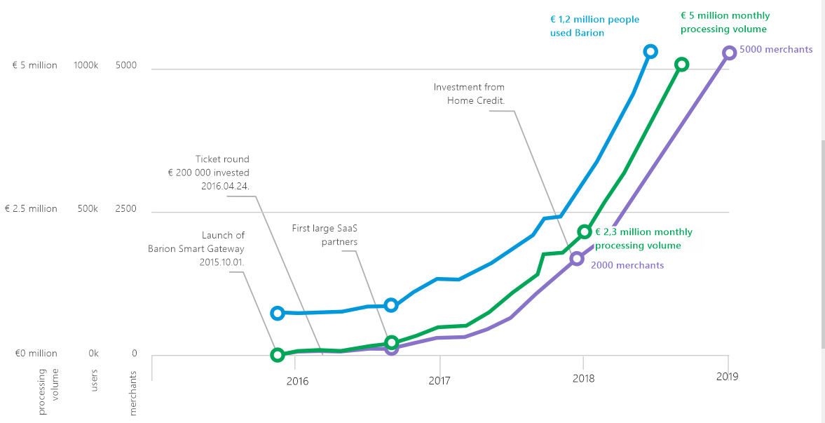
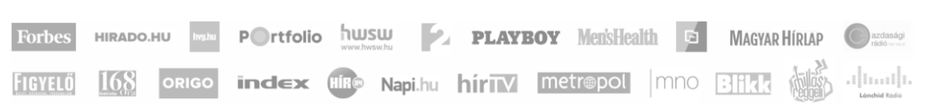
5000 merchants, 5 countries, 1.3M users, €15M(+€20M)/month
9
Notes:
Traction
Traction means having a measurable set of customers that serves to prove a potential.
9

Slide 10
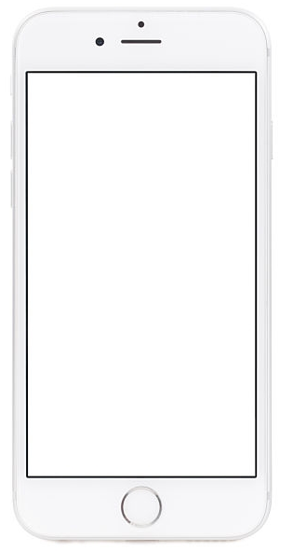
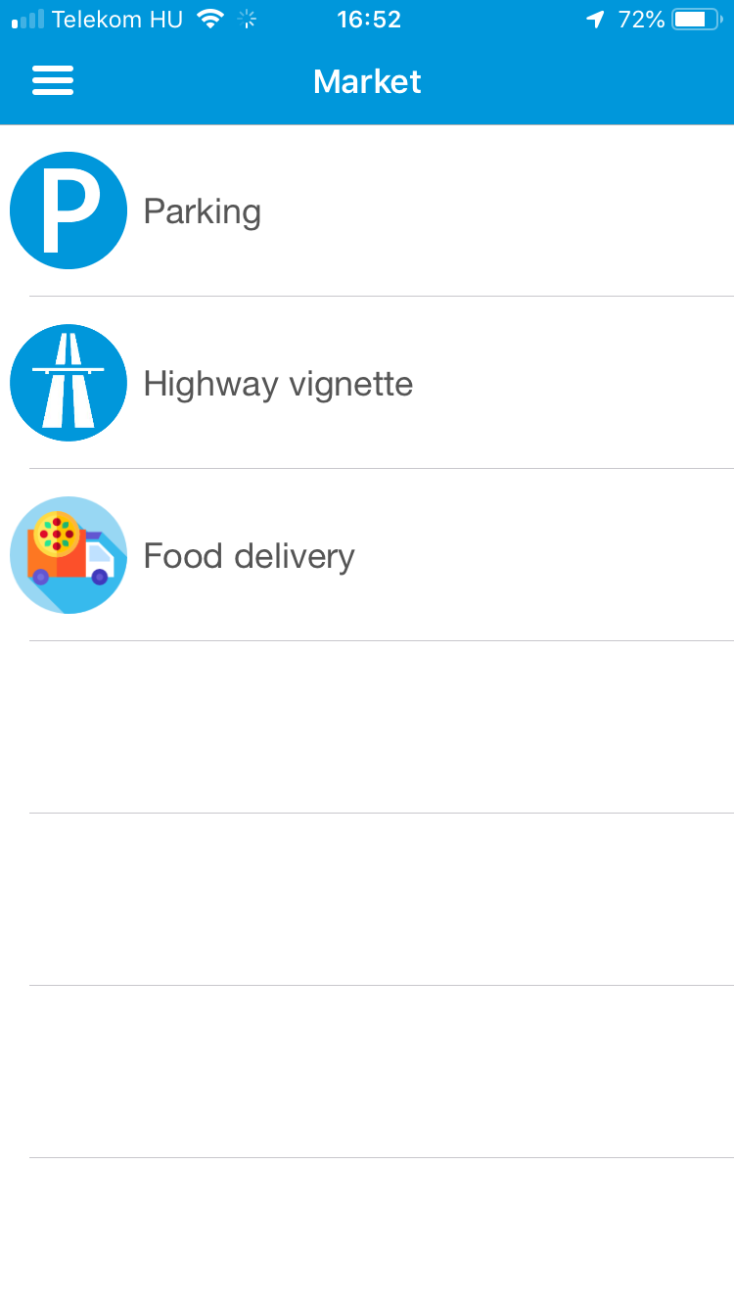
Barion Accounts: forget your bank
100 000+ private and business accounts
Onboarding is 2 minutes
Video KYC for business accounts
Selfie KYC for private accounts (under development)
Barion Market for own and third party apps
  Anyone can add new apps (Barion approval in needed)
  Seamless user experience (app styleguide)
  Simple multi lang/country app development process
10
Notes:
6. Product
How does your product or service actually work? Show some examples.
10

Slide 11
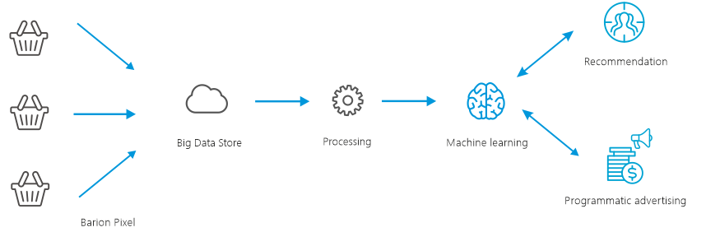
Barion Ads: personalized offers by machine learning & big data
11
Notes:
11

Slide 12
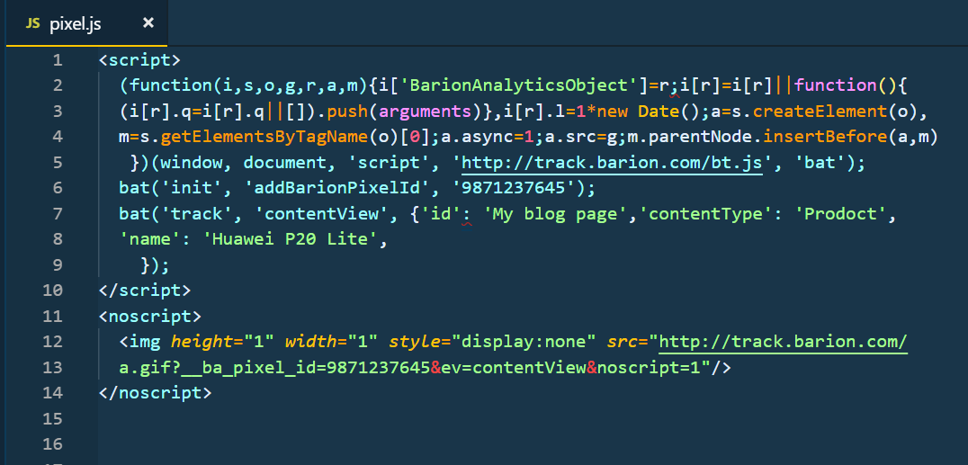
Barion Pixel: clickstream collector for Barion Ads
Placed on the website, e-mails, apps of Barion merchants and other partners.
Collects e-commerce centric events.
Fraud prevention on legitimate interest. Solves PSD2 RTS requirements.
Handles user consent.
12
Notes:
Product 2
How does your product or service actually work?
12

Slide 13
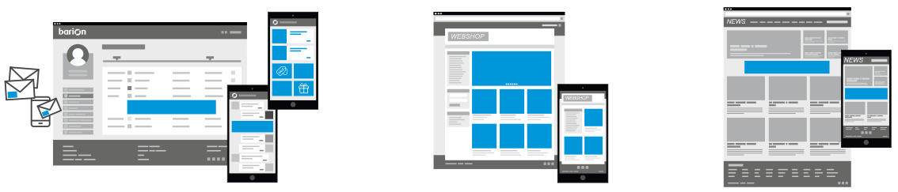



Monetization channels
Our own ad spaces and
Barion Market
Recommendation system in
merchants’ web shops
Programmatic advertising in 3rd party display ad networks
1st advertising customer:
1st programmatic agency partner:
13
Notes:
13

Slide 14
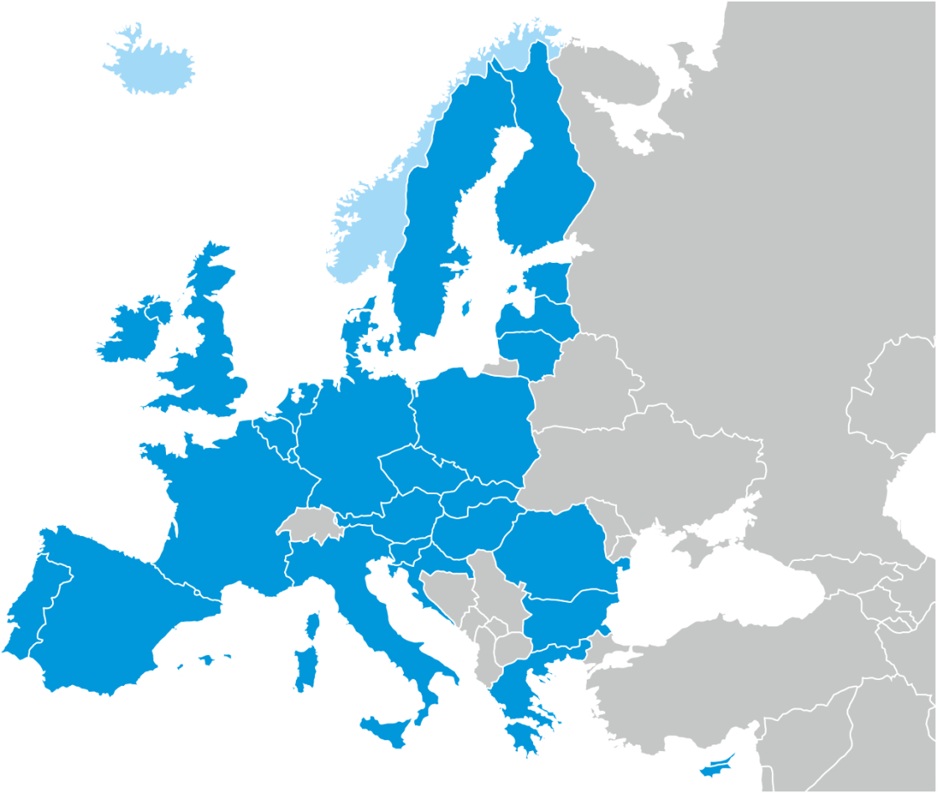
Barion is regulated business
Electronic Money Issuer* license issued by the Central Bank of Hungary. License id: H-EN-I-1064/2013, Issuer id: 25353192.
Capital requirements are met
Passporting to EU and the European Economic Area
Works in Czech Republic, Slovakia, Austria, Germany and Hungary
Series A investor: Home Credit (PPF Group) – 2+4M EUR
Multiple currencies supported (CZK, EUR, HUF, USD)
COBIT IT security
PCI DSS certification
Daily report to supervising authority
Regular audits
Barion™ is a European registered Trade Mark
*E-Money Directive 2009/110/EC http://ec.europa.eu/internal_market/payments/emoney/index_en.htm
Notes:
+1. Compliance
Is a license needed? Does Barion have a license?
14

Slide 15
This presentation contains Barion confidential information and is supplied on the understanding that it is solely for the use of the intended recipient.
WWW.BARION.COM
Sándor KISS
co-founder, CEO
+36 20 340 8303
sandor.kiss@barion.com
Barion Payment Inc.
H-1117, Budapest, Infopark st. 1.
+36 1 464 7070
hello@barion.com
Notes:
15

