Slide 1

Payment infrastructure of the Bank of Lithuania
LITHUANIAN - HUNGARIAN FINTECH FORUM & B2B
Vilnius, 23.05.2019
Asta Grigaitytė
Client Relationship Manager
2019-05-23, Vilnius

Slide 2

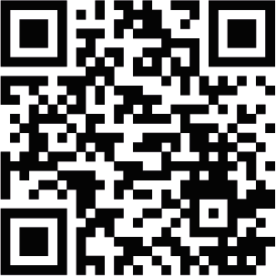
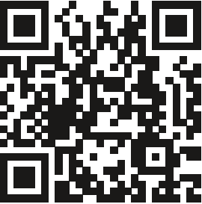
Central Bank for FinTechs
PROXY LOOKUP SERVICE

Slide 3
CENTROlink Services
SCT
SEPA Credit Transfers
SDD
SEPA Direct Debit Core
SCT Inst
SEPA Instant Payments
Creditor and Debtor / Debtor only

Slide 4
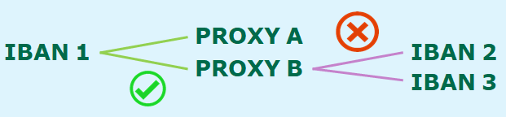
Proxy Lookup Service
PROXY types
MSISDN → mobile phone number
E-mail address
PROXY/IBAN relations
PLS service
24/7 up to date information
Connection to Pan-European PLS – on demand
Social network ID – on demand

Slide 5
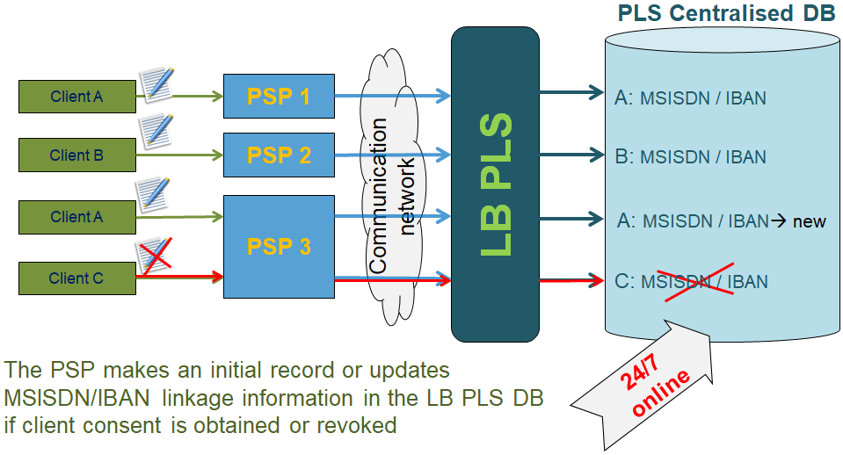
Proxy Lookup Service

Slide 6
Yes, but still… why BoL services?
One gateway and integration to SEPA schemes: STEP2 SCT, SDD Core, RT1 SCT Instant Payments and Proxy Lookup Service;
No entry or annual fees, only transaction fees for SCT, SDD and SCT Instant schemes (minimum monthly fee);
Availability for PI/EMI to participate as ABIC holders via the direct participant The Bank of Lithuania;
Smooth integration – full assistance of BoL Team;
On boarding in 3-6 months;
Multilingual Service Desk Team;
Innovative approach and attention to clients’ needs for future projects;
Clients safeguarding account with The Bank of Lithuania (no credit risk);
Possibility to issue Lithuanian IBAN accounts for the clients (if the entity resides in Lithuania).

Slide 7
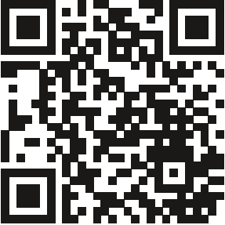
www.centro.link centrolink@lb.lt
+370 5 268 0819
+370 5 268 0618

