Slide 1


Lithuania: Direction→ FinTech
Rūta Merkevičiūtė,
Head of Division
Bank of Lithuania

Slide 2

Commitment of all competent authorities
Main goal:
To support financial innovation in the interests of consumers
National Fintech Strategy (from 2017)
Network of competent public authorities
Bank of Lithuania : Partnership approach

Slide 3












Network of authorities

Slide 4
Bank of Lithuania: Partnership approach
Accelerate
Guide
Set example
Reduced unnecessary entry barriers to the financial market
Access to Central bank payments infrastructure
for payments service providers
Access to credit data
for Fintechs
LEVEL PLAYING FIELD

Slide 5
Achievements and way forward
Remote client identification ✓
Crowdfunding / peer-to-peer lending regulation ✓
Encourage Fintech society to establish association ✓
Newcomer programme in BoL ✓
Regulatory sandbox ✓
E-licencing ✓
Centrolink payment systems ✓
Improved regulation on asset management✓
Regulation of P2P insurance
E-residency
Regulation of virtual assets

Slide 6
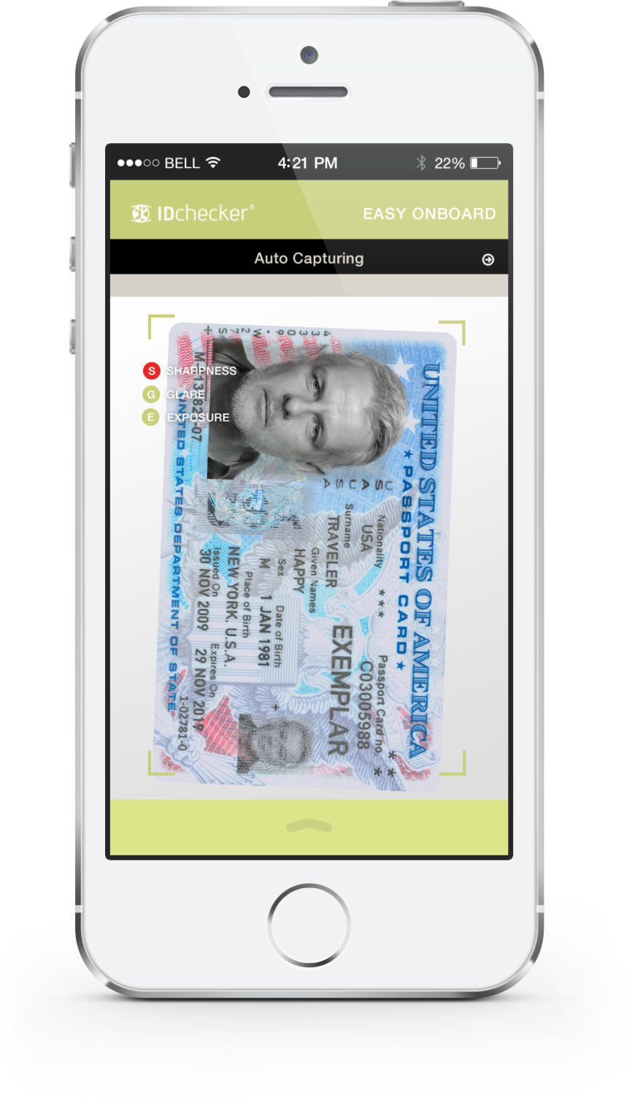
Remote client identification
Identification via e-signature, e-identification means
Possibility to identify using direct video/image transmission (video conversation/real time photo capturing)

Slide 7
Crowdfunding / Peer – to peer lending regulation
Introduced Crowdfunding/P2P operators regime
Alternative to banking lending: Enables investor directly invest/lend to the debtor/project
11 Crowdfunding platforms
5 P2P lending platforms
Investors
WWW
Platform
Debtor/ Project

Slide 8
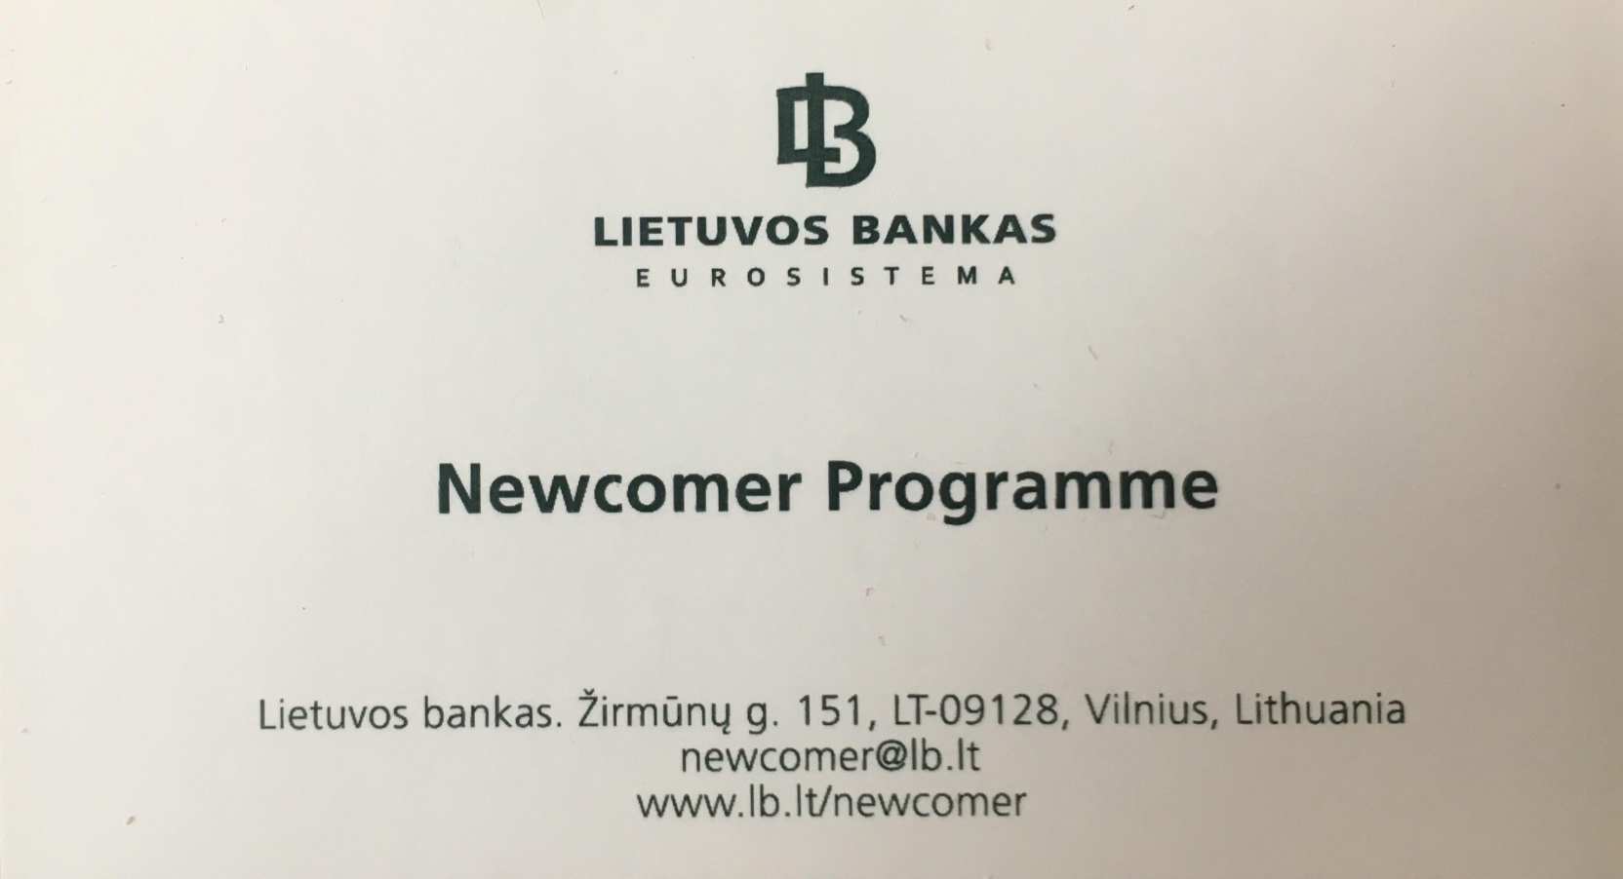
Newcomer programme in BoL
Possibility to meet with regulator to set mutual expectations
One stop for meetings and consultations with potential financial market participants
Basic information about licensing and financial services opportunities in Lithuania
Checking whether future plans are in line with legislative and licensing requirements

Slide 9
Licencing requirements
Requirements / Type of license | Bank | Specialised Bank | EMI | PI
Initial capital | 5.000.000 | 1.000.000 | 350.000 | 20.000-125.000
License fee | 4.157 | 4.157 | 1.463 | 898
Supervision fee | 0.0153% of assets | 0.0153% of assets | 0.585% of income | 0.585% of income
Assessment period | Up to 6 months (can be extended to 12) | Up to 6 months (can be extended to 12) | Up to 3 months (can be extended) | Up to 3 months (can be extended)

Slide 10

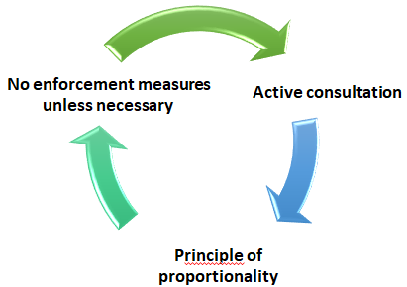

Regulatory sandbox
Sandbox Regulatory sandbox
Launched on 15 th October, 2018
Allows test innovative FinTech products or business models in a live environment, with real consumers under the guidance and supervision of the Bank of Lithuania.

Slide 11
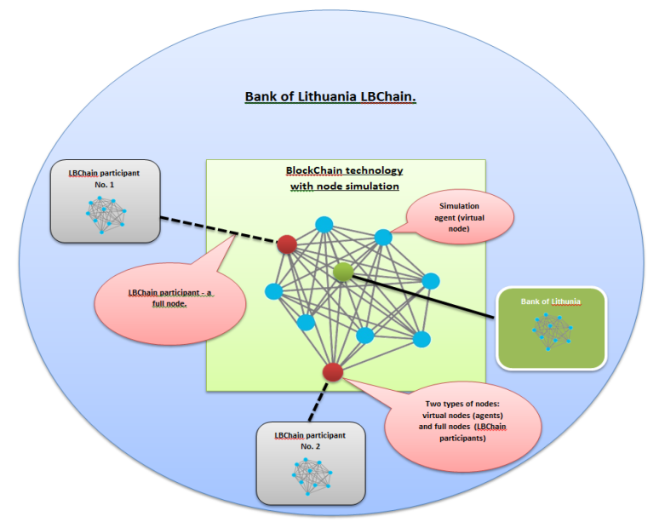
Blockchain sandbox - LBChain
Blockchain-based sandbox, run by Bank of Lithuania, combining (technology) infrastructure + regulatory support
R&D with IBM, Delloitte and Tieto
Ready for testing – from September, 2019
Launch – from January, 2020

Slide 12
Fulfilling needs of every stage company
Idea
MVP
Ready to launch
LBChain: blockchain
sandbox
Regulatory sandbox
Newcomer programme / Licensing
Notes:
Goals:
Accelerate the development and application of blockchain-based solutions in the financial sector
Improve the quality of regulation in the financial sector

Slide 13
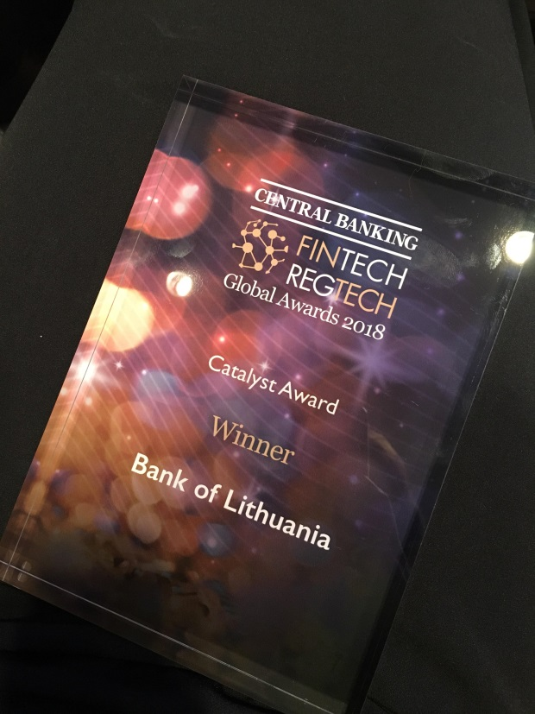
E-licensing
RegTech:
E-licensing tool for online application submission

Slide 14
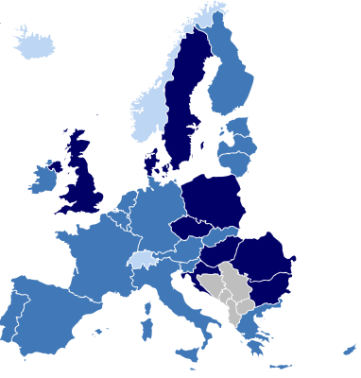
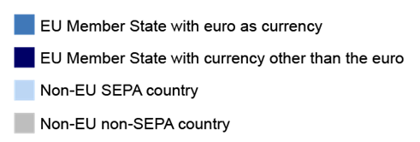
Centrolink payment system
CENTROlink – payment system, operated by BoL
Technical access for non-banks
Credit and instant transfers, direct debits
Full SEPA reachability (34 countries)

Slide 15





Centrolink payment system
Paricipants:
14 banks and credit unions,
67 EMI/PI, expected to have 100 EMI/PI by the end of this year
Cash flow:
2018 over 20 million operations worth over 62 billion. Eur.
In 2019 - 75% monthly payments growth compared to 2018

Slide 16
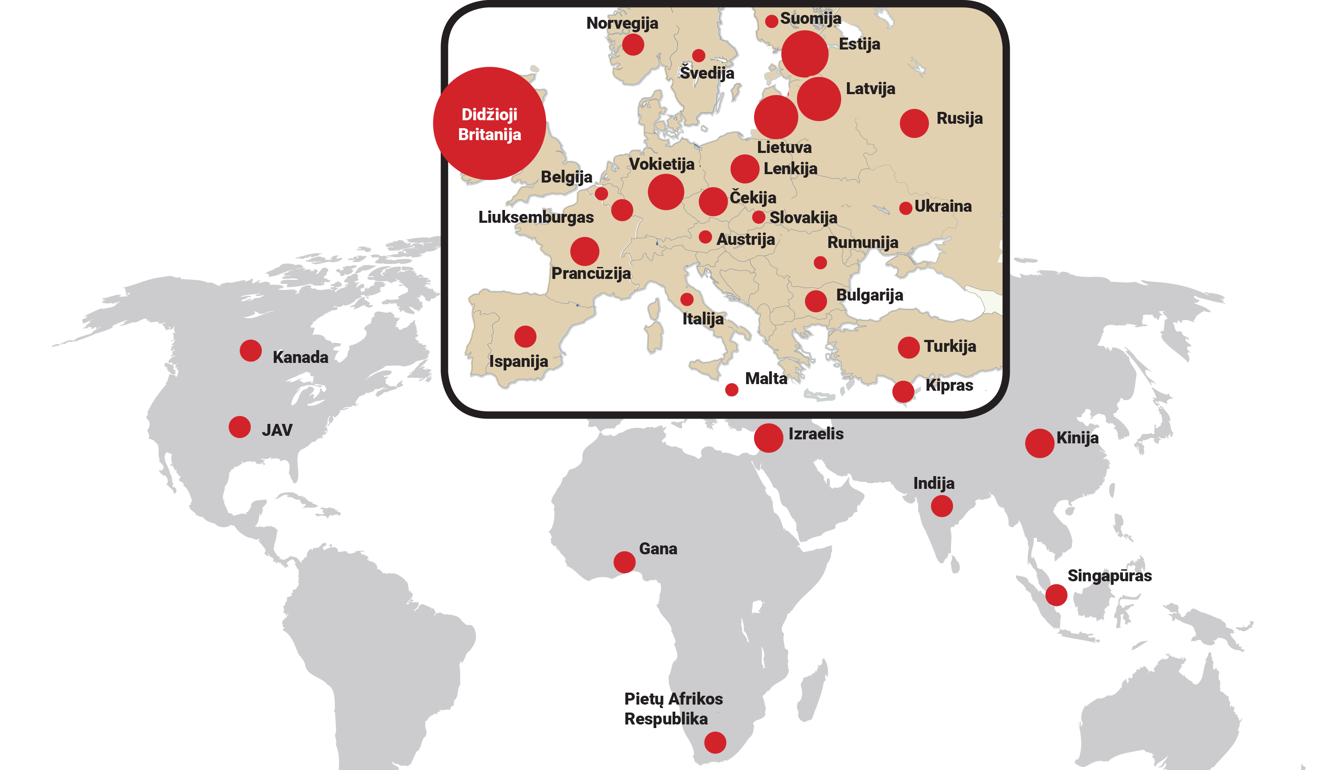
Results
More than 250 companies that expressed interest
From 32 countries

Slide 17
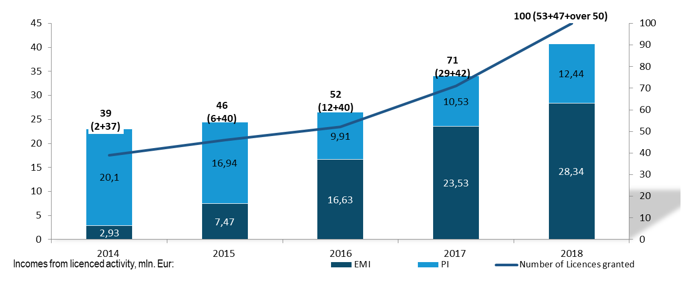
Growing sector

Slide 18
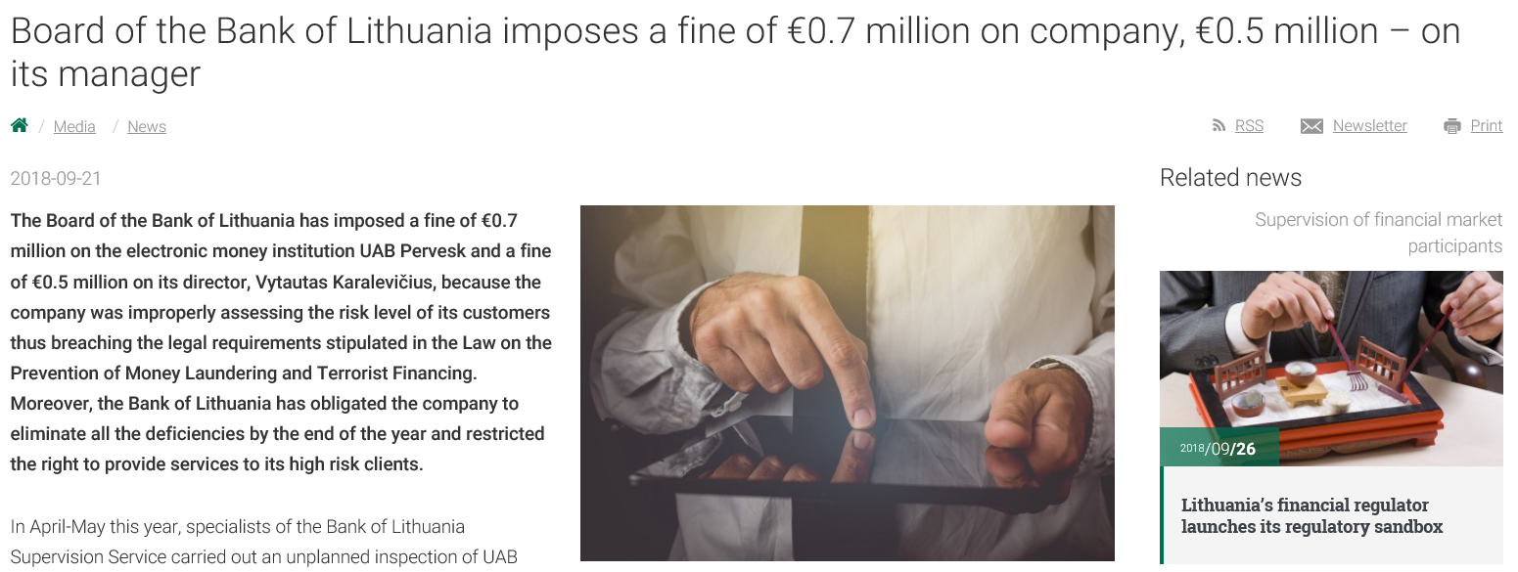
At the same time, we stay watchdog

Slide 19
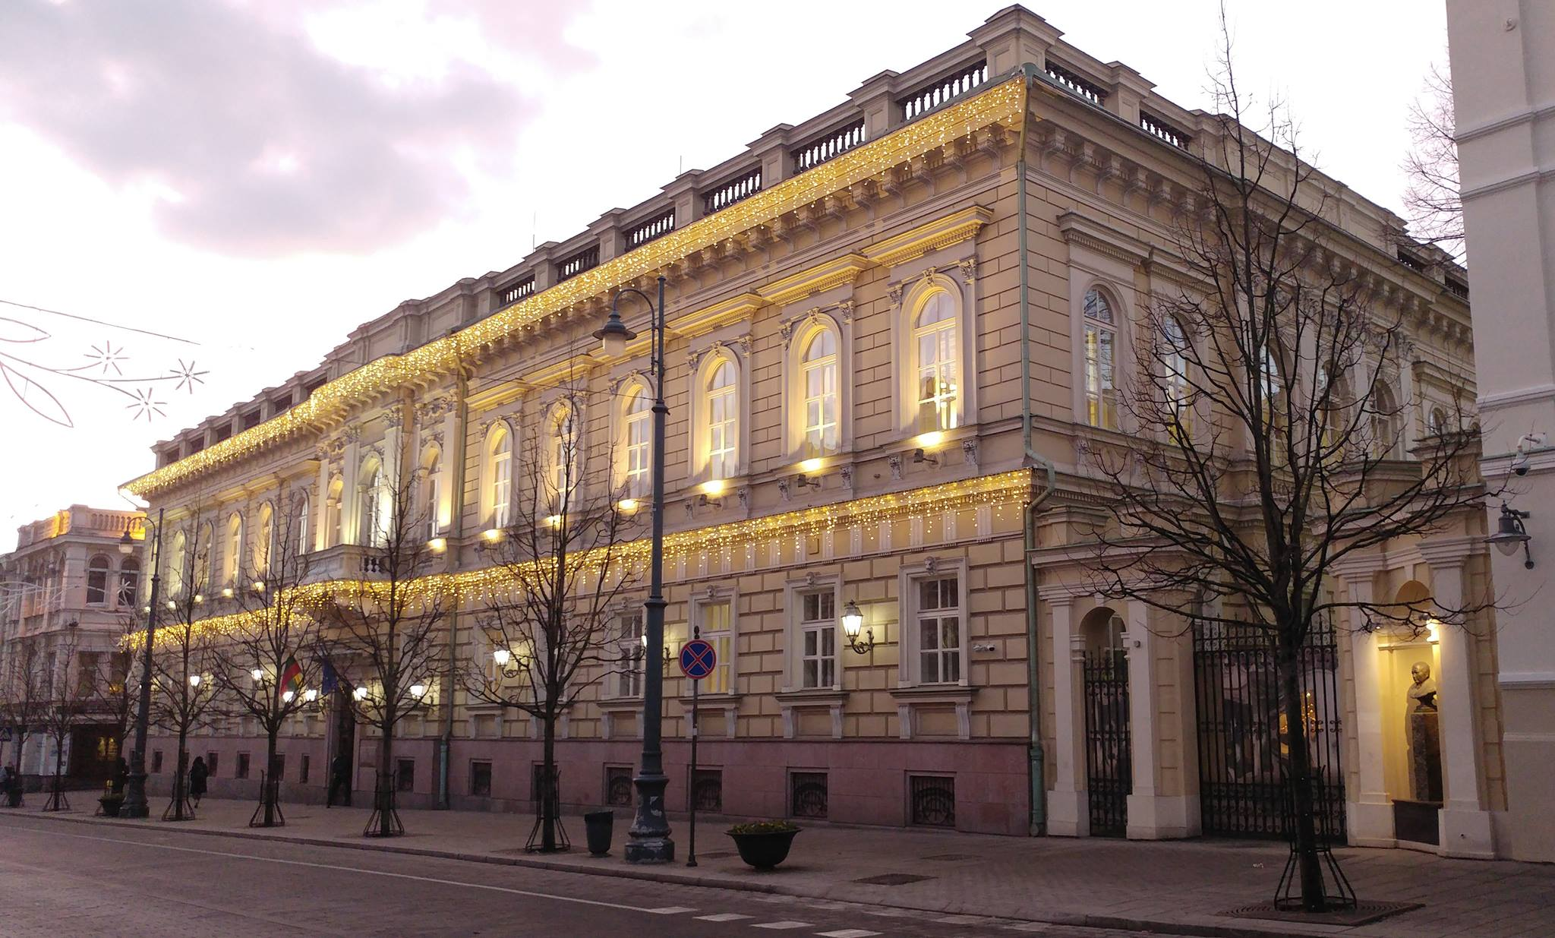
Thank you

